Slide 1
Shashwath Upaay Sustainable Solutions For Farming
Our Team
Amardeep Anusha Harsha
Jaldeep Minal Pradnya
Ryetika (Mentor) Sai Sreehari

Slide 2
Outline
The Story
Problem Definition / Informational Gap
Demo / POC
Solution / Concept
Impact
Innovation
Technical Achievement
Sustainability
Business Plan

Slide 3

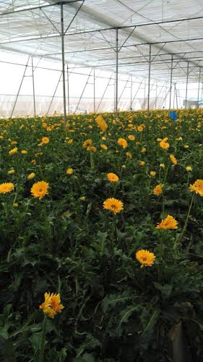
Present Scenario of Malti’s Farm
Malti has been farming only based on intuition and past experience
No historical trending of weather conditions
No advisory based on local weather forecasts and scientific farming practices
Manual monitoring of soil, temperature, humidity, light etc, all across the farmed area
No access to affordable monitoring and controlling technology

Slide 4
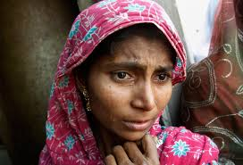
As a result…
Low Productivity
Manual Maintenance
High Financial Debt
Farmer Stress
Crop Loss
High Risk

Slide 5





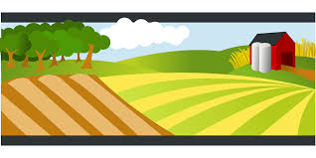

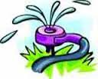

The IoT Solution
Collect Farm status
Perform Remediation
Tx remediation command
Collect forecast
Upload Farm status
Remote Sensing
Shashwath Upaay
Suggest Troubleshooting
Upload Sensed data
Perform Remediation
Predictive Analysis
Automatic Remediation
Sensors
Remediation

Slide 6
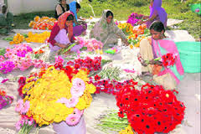
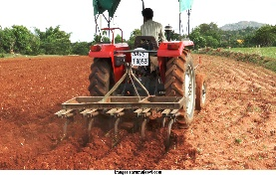
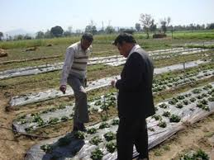
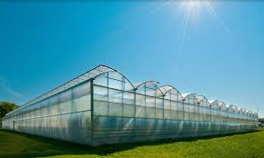
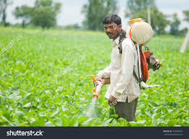
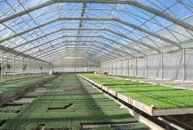
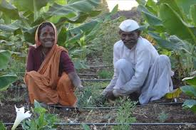
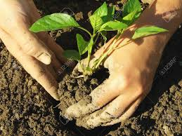
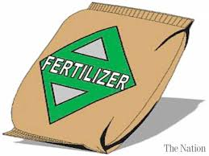
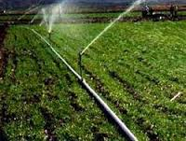
Benefits of the Solution
Harvesting
Land Preparation
Green House Preparation
Surveillance
Full crop cycle monitoring and risk mitigation
Automatic alert when farm conditions are unhealthy
(based on crop type, sensed data and forecast)
Remote remediation with the click of a button
Best practices by using scientific farming methodology
Lesser losses, higher productivity ➔ Higher Net benefits
Pesticide Application
Crop nursery
Weeding
Sowing/ Planting
Irrigation
Fertilizer Application
Notes:
Alert and/or automatically control the sensors based on crop, weather (past, current and future), soil, region and season
Right time to sow
To maintain crop conducive environment
Irrigation management
Fertilizer application
Pest and disease management
Crop growth monitoring
Right time to harvest
Sustainable farming
Ultimately minimization of farming risks, increase in production and higher net benefits

Slide 7
Innovation
Integrating multiple technologies for Smart Farming
IoT: Raspberry Pi based sensor and remediation trigger
Azure: Cloud storage
aWhere: forecast data
Android App
Solution deployment in different farm conditions
Real time farm monitoring
Ease of access: monitor and manage your farm through hand held devices

Slide 8
Staging
Stage 1
Stage 2
Stage 3
Focus on GreenHouse
Only horticulture crops
Temperature sensing
Humidity sensing
Soil sensing
Wind sensing
Azure, cloud storage
aWhere, data integration
Android App
Solution upgrade capability
Focus on open fields
All crops
Light sensing
Outside weather sensing
Android App upgrade
Remote and automated management capabilities
Standardize the sensing equipment to Indian field customers
Android App upgrade

Slide 9
Thank You

